Slide 1
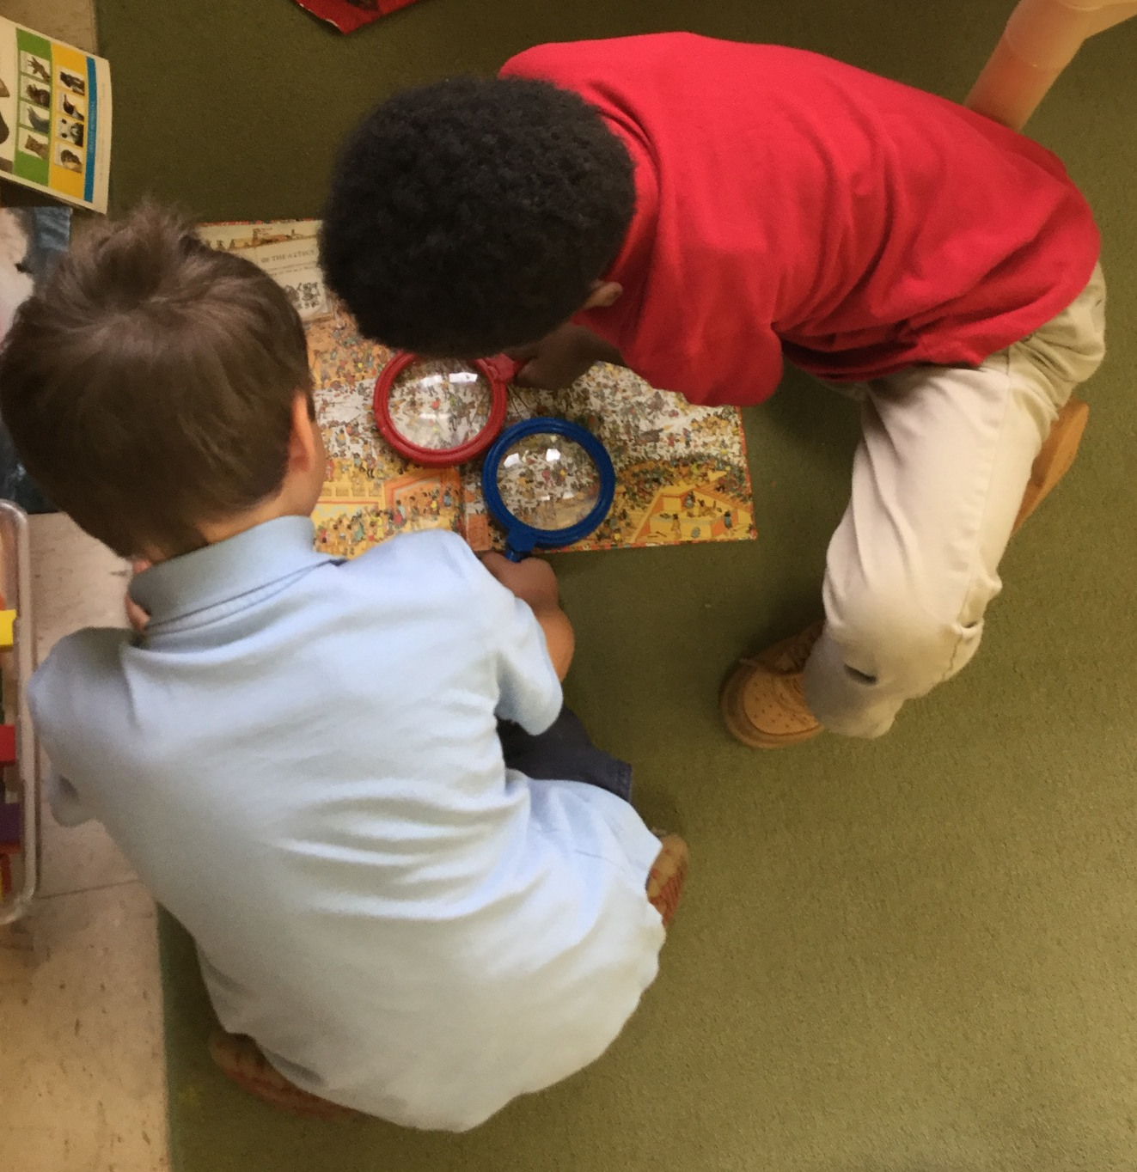
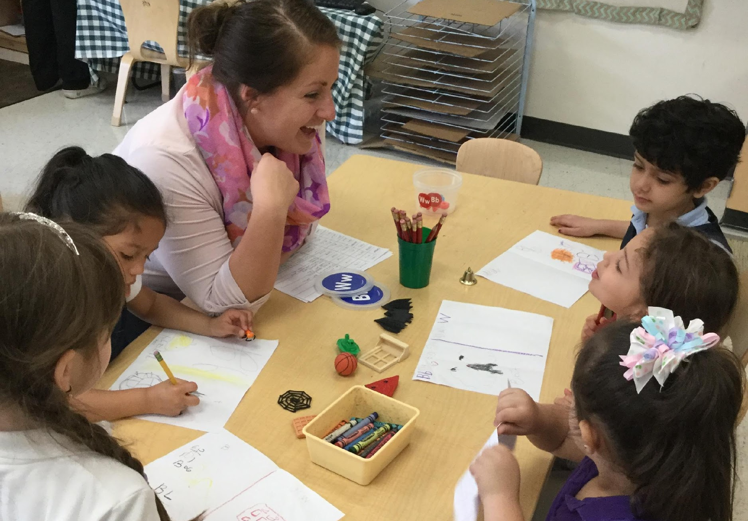
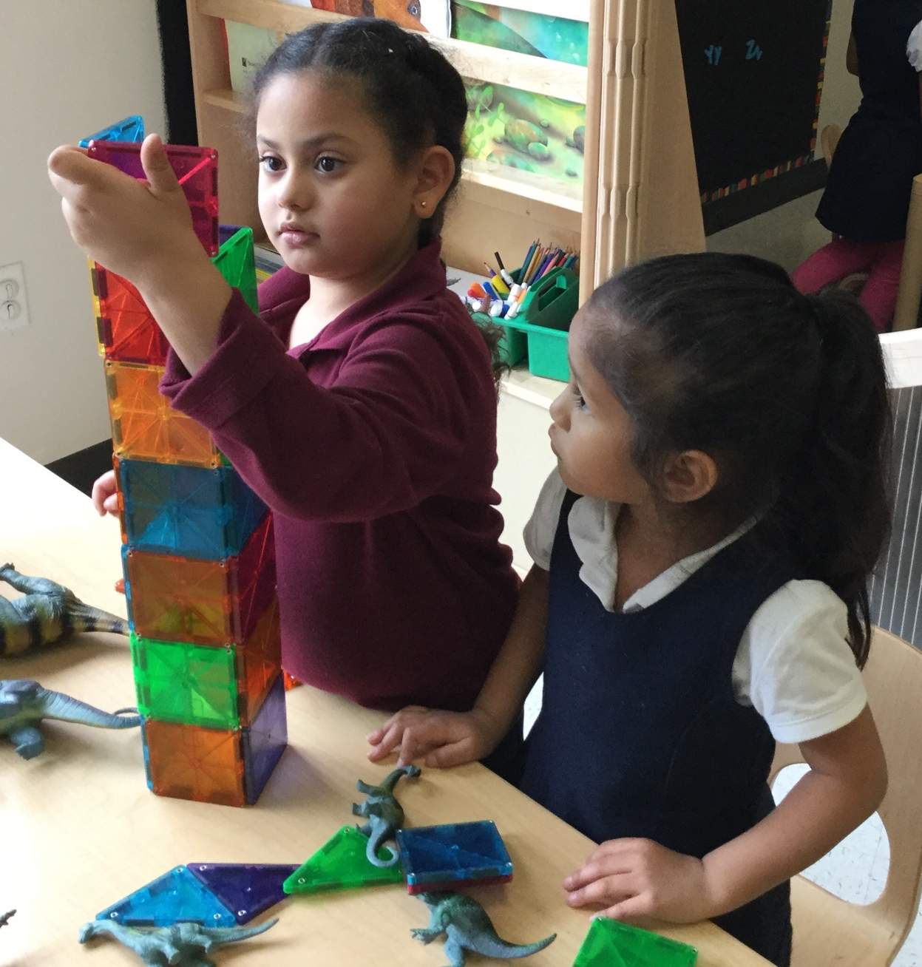
Creating a Positive Climate
CHALK PROFESSIONAL DEVELOPMENT SERIES

Slide 2
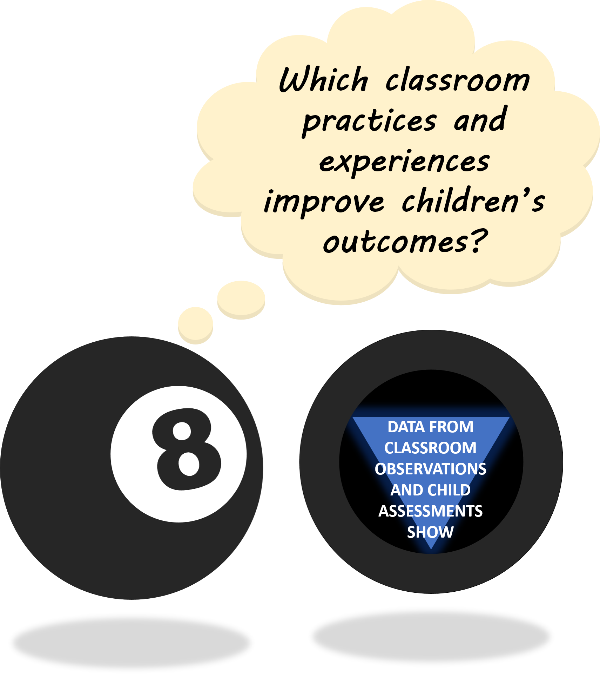
THE “MAGIC 8” CLASSROOM PRACTICES
Reduce time spent in transition
Improving level of instruction
Creating a positive climate
Increasing teacher listening to children
Planning sequential activities
Promoting associative and cooperative practices
Fostering high levels of engagement
Providing math opportunities
★ 2017-18 Initiative: Focus on Literacy ★

Slide 3
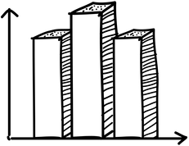
WHY CLASSROOM EMOTIONAL CLIMATE MATTERS
Children who are emotionally supported in their classrooms will
Feel valued and safe
Interact more with teachers and peers
Be more highly engaged in learning activities
Take academic risks!
In MNPS ELC Classrooms
Children who experienced emotionally supportive classrooms showed much stronger gains in spelling and writing, vocabulary, and math knowledge.
This was especially true for children who entered pre-k with lower skills than their peers!
Notes:
According to evidence from prior PRI research, children who experienced preschool settings with a) more positive peer interactions and b) teachers who had a more positive emotional tone and c) spent more time positively reinforcing behavior had significantly greater social competence and fewer problem behaviors in first grade (Spivak & Farran, 2014).
Discussion topic: Why do you think emotionally supportive classrooms environments were especially important for children with lower entering skills?

Slide 4
MARKERS OF A POSITIVE EMOTIONAL CLASSROOM CLIMATE
Positive classrooms are marked by responsive teachers, who manage behavior and attention challenges, as well as social and emotional needs for individual children.
Key aspects of responsive teaching include using behavior-approving language more frequently than redirecting, using specific praise, and maintaining a pleasant affect and tone in teacher-child interactions.
Using behavior-approving language more frequently than redirecting
Using specific praise
Maintaining a pleasant affect in interactions with children
Notes:
A person's affect is the expression of emotion or feelings displayed to others through facial expressions, hand gestures, voice tone, and other emotional signs such as laughter or tears

Slide 5
MAXIMIZE BEHAVIOR APPROVALS & USE SPECIFIC PRAISE
Behavior Approvals are verbal or nonverbal messages that say to a child:
“I like what you’re doing and I want you to keep doing it.”
Praise is most effective when it is meaningful and concrete. Praise should be specific to children’s actions, efforts, accomplishments. When possible, focus on effort as opposed to ability – this encourages children to focus on the process, rather than achieving the “right answer”.
“That’s a really creative suggestion for
another ending to the story.”
“It was so kind of you to work together to solve the problem of having too many friends in the art center!”
“I can tell you really worked hard to sort
all of those dinosaurs.”
Notes:
Refer teachers to handout for examples
BA also aids in development of behavioral self-regulation
Statements like …“Kiss your brain!” “Good job!” “High five!” “You’re so smart!” “Great! That’s the right answer!” are quick, easy ways to positively acknowledge a child’s behavior or contribution; meaningful praise has the potential to make a child feel special and gives feedback about the behaviors and attributes that are most valued in the classroom.
Discussion point: Think about the behaviors that your reinforce in your classroom. What messages are children getting about what matters most in your community of learners?

Slide 6
LIMIT REDIRECTIONS
With Redirections, the intent is to change the child’s behavior. They say to the child:
“I want you to do something different from what you are doing.”
IMPORTANT: Some redirection is necessary for running the classroom and keeping children safe! The goal here is not to eliminate redirections, but for children to receive comparatively more positive, affirming messages about their behavior.
Examples of Redirections:
Disapproving facial expressions, verbal comments, tone of voice, physical contact with children.
Statements do not have to be negative in tone to be a redirection.
“Remember, keep your hands to yourself Suzy.”
“I said stay in your space, Jonathan.”
“Are you making a good choice?”
Notes:
With redirections, the teacher/EA’s intent is to change the child’s behavior; to say to the child, “I want you to do something different from what you are doing.” Teacher/EA uses disapproving facial expressions, verbal comments, tone of voice, and/or physical contact with children. Statements do not have to be negative in tone to be a redirection.
Non-verbal Examples of
Behavior Redirection:
Grimacing, frowning, side-to-side head-shaking, gesturing
Verbal Examples of
Behavior Redirection:
“Criss-cross applesauce, Jonathan.”
“Put a bubble in it, Janie.”
“Are you making a good choice?”
Threats and sarcasm are disrespectful and potentially damaging to children. These are inappropriate forms of redirection.

Slide 7

SETTING EXPECTATIONS
Initial instructions are not redirections.
Redirections are reactive to behavior that has already occurred.
Setting expectations upfront can be a great way to limit redirections! For example:
“When we all walk down the hall, we are using safe bodies. Who can tell me another way we can have safe bodies?”
“We have center cards that show you how many friends can be in each center. Use the center cards to help you make your center choice.”
IMAGE SOURCE
Notes:
Suggested measurable action – teacher’s can tally one another

Slide 8

AVOID THREATS, SARCASM, & DEROGATORY COMMENTS
Threats and sarcasm are inappropriate forms of redirection. These are disrespectful and potentially damaging to children.
“You must not want to go to the playground today, Keisha!”
“If you’re not bleeding or on fire, then I don’t want to hear from you.”
“I just love repeating myself.”
Eye Rolling
Derogatory comments made to other adults within an earshot of children should also be avoided.
“She’s crying because her mom babies her too much.”
“Well you know he isn’t getting a positive example at home.”
Notes:
With redirections, the teacher/EA’s intent is to change the child’s behavior; to say to the child, “I want you to do something different from what you are doing.” Teacher/EA uses disapproving facial expressions, verbal comments, tone of voice, and/or physical contact with children. Statements do not have to be negative in tone to be a redirection.
Non-verbal Examples of
Behavior Redirection:
Grimacing, frowning, side-to-side head-shaking, gesturing
Verbal Examples of
Behavior Redirection:
“Criss-cross applesauce, Jonathan.”
“Put a bubble in it, Janie.”
“Are you making a good choice?”
Threats and sarcasm are disrespectful and potentially damaging to children. These are inappropriate forms of redirection.

Slide 9
INDICATORS OF TEACHER AFFECT/EMOTIONAL TONE
POSITIVE | Vibrant | Strong positive interaction – genuine excitement for teaching
 | Pleasant | Shows positive interest – smiling, eye contact, eyebrows raised, leaning forward
 | Neutral | Shows no facial expression – neutral affect, “resting face”
NEGATIVE | Negative | Negative affect — frowning, headshaking, negative gestures, eye rolling, sighing; may use mild threats
 | Extreme Negative | Strongly negative affect – sarcasm, yelling, insults; physically dragging/pulling child

Slide 10
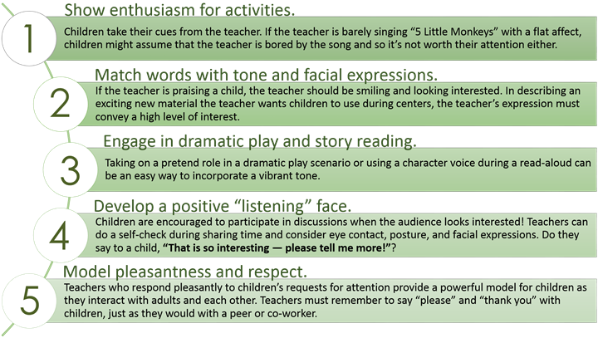
FIVE WAYS TO IMPROVE TEACHER TONE

Slide 11

SPECIAL THANKS & ADDITIONAL RESOURCES
We are grateful to the following MNPS Pre-K Instructional Coaches and Multi-Classroom Leaders for their invaluable feedback in developing these materials:
SeTara DeThrow
Carrie Head
Susan McClain
Stephanie Mullins
Holly Stone
Ashley Aldridge Wilson
Rhiannon Wilson
https://my.vanderbilt.edu/mnpspartnership/

Slide 12
INDIVIDUAL IMAGE SOURCES
FREQUENTLY USED IMAGES*
ADDITIONAL IMAGE SOURCES
Lightbulb | myiconfinder.com
Designed by Vexels.com:
Hand drawn magnifying glass
Hand drawn bar graph
Pie chart hand drawn doodle
Hand drawn wall clock
Hand drawn cloud bubble
Hand drawn open book
Cog wheel hand drawn icon
Slide 7: Children lined up | clipart-library.com
Slide 8: Grimace emoji | emojidex.com
*These graphics are used as icons throughout the series. For example this lightbulb clipart appears beside most “Discussion Point” questions.

